Slide 1
HOMEROOM
April 8th, 2024

Slide 2
Agenda: 1. Why High School? 2. Academic Study Habits 3. Grade Check 4. End of Q3, Start of Q4 plan

Slide 3
Education Pays…
In 2022 -
workers age 25 and over without a high school diploma had median weekly earnings of $682.
Workers whose highest level of education was a diploma made $853 per week, or just over 25 percent more than those who didn’t finish high school
and earnings improved with every level of education completed.

Slide 4
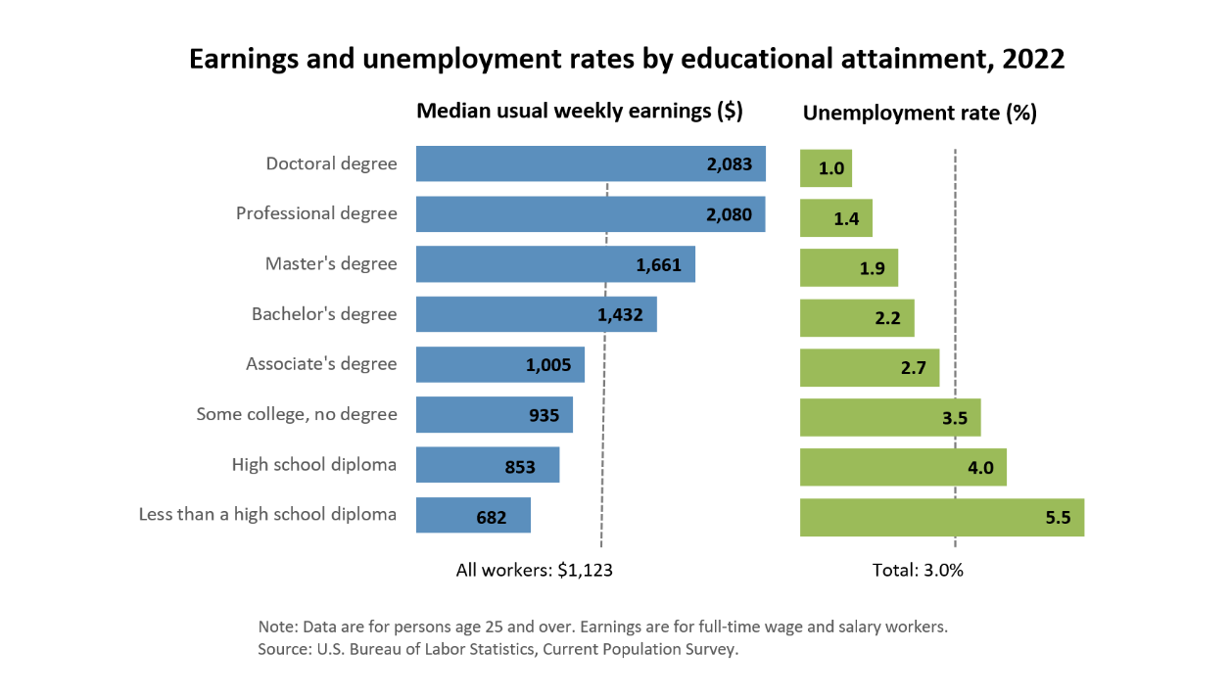
WHY HIGH SCHOOL?

Slide 5
What do you notice about this data?
With a high school diploma, you earn 25 % more.
The more education you have, the higher you get paid!
The higher your education, the more likely you are to be employed.

Slide 6
Why are we telling you this?
When you say “I don’t get paid to go to school…”
Actually you do… you will get paid more and have more opportunity with a more education!
We want you to graduate!
(and we’re here to help you do that!)

Slide 7
3 Key ideas to help you Graduate…
1. Attendance – be here!
2. Ask for help! – we want you to be successful.
3. Practice good habits – turn in work on time, study for tests, complete assignments.

Slide 8
DEFINING STUDY HABITS
Study habits are the routines and practices students use when preparing for tests, completing assignments, or learning new material.
Good study habits can help you manage your time efficiently, retain information better, and reduce stress.

Slide 9
WHY are study habits important?
Increased learning
Better grades
Improved retention of information

Slide 10
What are your current study habits?
Turn and share what you do to study with the person next to you.
Be prepared to share.

Slide 11
Common Obstacles to Good Study Habits
procrastination, poor attendance, lack of focus, or poor time management.
What are your obstacles? Think about it for a few minutes.

Slide 12
THINK – PAIR - SHARE
Turn to your neighbor and discuss what your bad study habits are…
then discuss what you think good study habits are.

Slide 13
Strategies to Improve Study Habits
Creating a dedicated study space.
Setting specific goals for each study session.
Using active learning techniques like summarizing and teaching.
Avoiding distractions (e.g., turning off phones).
Taking regular breaks.
Using study aids like flashcards or study groups

Slide 14
Consistency in Habit
Creating new habits means making a commitment… And staying consistent.
Take the self-assessment to evaluate your current study habits.

Slide 15
Consistency in Habit
Creating new habits means making a commitment… And staying consistent.
Take the self-assessment to evaluate your current study habits.

Slide 16
Create Your OWN Schedule
On the bottom of your assessment sheet, complete the questions.
Identify one bad habit that you have.
Identify one good study habit you want to create.
Write a short schedule to help you commit to creating that good habit.

Slide 17
Follow UP!
Share what you learned today with a friend or family member –
tell them about your commitment to improving your habits!

Slide 18
Last, but not least, GRADE CHECK! Are you passing all classes? Check your PowerSchool!

Slide 19
1. Meet with your teacher before or after school. 2. Make an appointment to get extra support in the HUB. 3. Sign up for a Connect Time Academic Help Session
If you are failing a class, what can you do?

Slide 20
Upcoming Calendar
Friday April 12th – Spring Sports Con
ASB election speeches and vote
Friday April 12th – END OF Q3
Monday April 15th – student choice Connect Time (be sure you sign up!)
Friday April 19th – Spring Fling MIXER 8:00-10:00PM
Tuesday April 23rd – T24 Day – learn about trades, community college and university options

Slide 21
Proud to be SP!

